Slide 1


Analog Project
Automatic Solar Tracker
Electron Envoys

Slide 2
Contents
Block Diagram
Specifications
Theory
Description of functional components
PCB design
Enclosure design
Testing
Conclusion

Slide 3
Block Diagram
Sunlight Sensing
Differential Amplifier
PID controller
Summing amplifier
Motor controller
Motor
Sunlight Sensing

Slide 4
Specifications
Supply voltages: +12V, -12V
Power Consumption – 1.4W
Op amps used: TLV9352
Motor driver: L293D
LDR used – Advanced Photonix NSL-4960
LDR light resistance - <5kΩ
LDR dark resistance 1MΩ
PCB – 2 layer PCB manufactured by JLCPCB China
Enclosure – Aluminum frame with plywood surfaces

Slide 5
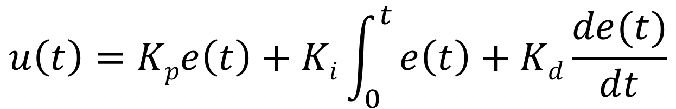

Theory
e(t)
$$Σ$$
PID Control
u(t)
Process
-1
$$u\left(t\right)=Kpe\left(t\right)+Ki\int_{0}^{t}{e\left(t\right)+Kd\frac{de(t)}{dt}}$$

Slide 6
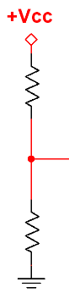
Functional Components
Voltage Dividers
A voltage divider is made with a Light Dependent Resistor and a fixed resistor
The voltage between these two resistors is sent to an input buffer
This implementation of the solar tracker contains two such voltage dividers in order to check if the sunlight on both resistors is the same

Slide 7
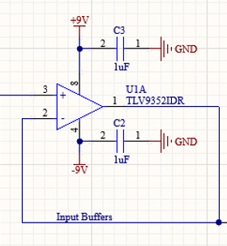
Functional Components
Input Buffers
Each voltage divider input has input buffers
The purpose of these is to minimize the current drawn by the op amps from the voltage divider network.
There are two such buffers and these outputs are sent to the two inputs of a differential amplifier.

Slide 8
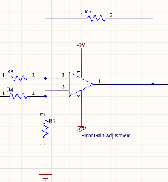
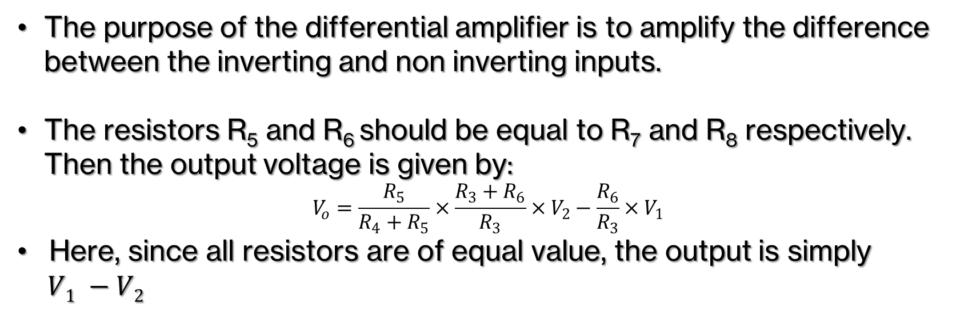
Functional Components
V₁
V₂
Differential Amplifier
The purpose of the differential amplifier is to amplify the difference between the inverting and non inverting inputs.
The resistors R₅ and R₆ should be equal to R₇ and R₈ respectively. Then the output voltage is given by:
$$V_{o}=\frac{R_{5}}{R_{4}+R_{5}}×\frac{R_{3}+R_{6}}{R_{3}}×V_{2}−\frac{R_{6}}{R_{3}}×V_{1}$$
Here, since all resistors are of equal value, the output is simply
$V1 −V2$

Slide 9
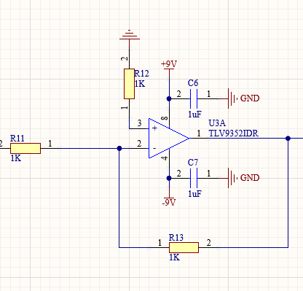
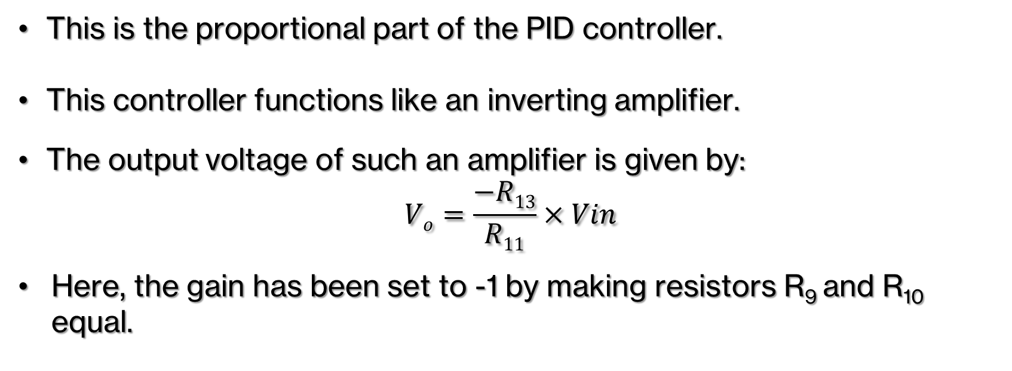
Functional Components
Proportional Controller
This is the proportional part of the PID controller.
This controller functions like an inverting amplifier.
The output voltage of such an amplifier is given by:
$$Vo=\frac{−R13}{R11}×Vin$$
Here, the gain has been set to -1 by making resistors R₉ and R₁₀ equal.

Slide 10
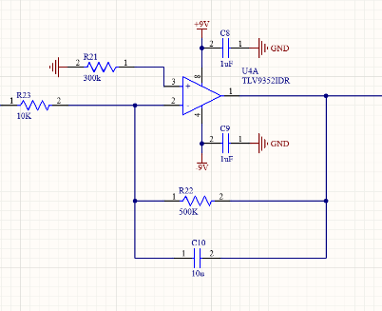
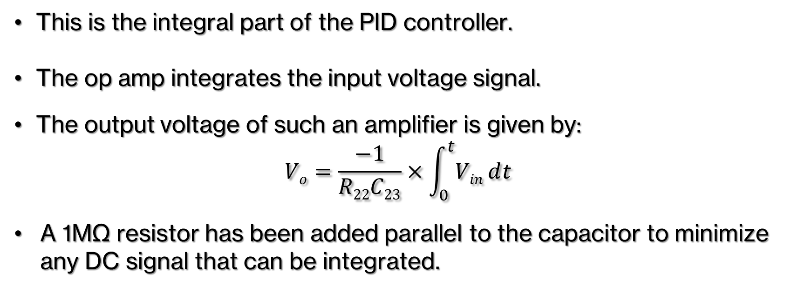
Functional Components
Integral Controller
This is the integral part of the PID controller.
The op amp integrates the input voltage signal.
The output voltage of such an amplifier is given by:
$$Vo=\frac{−1}{R22C23}×\int_{0}^{t}{Vinⅆt}$$
A 1MΩ resistor has been added parallel to the capacitor to minimize any DC signal that can be integrated.

Slide 11
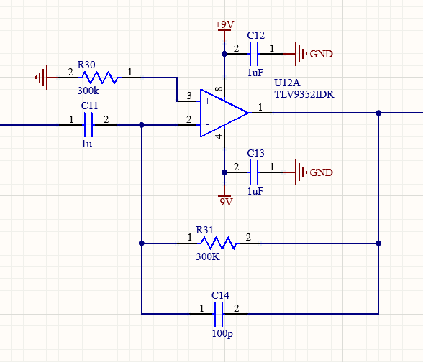
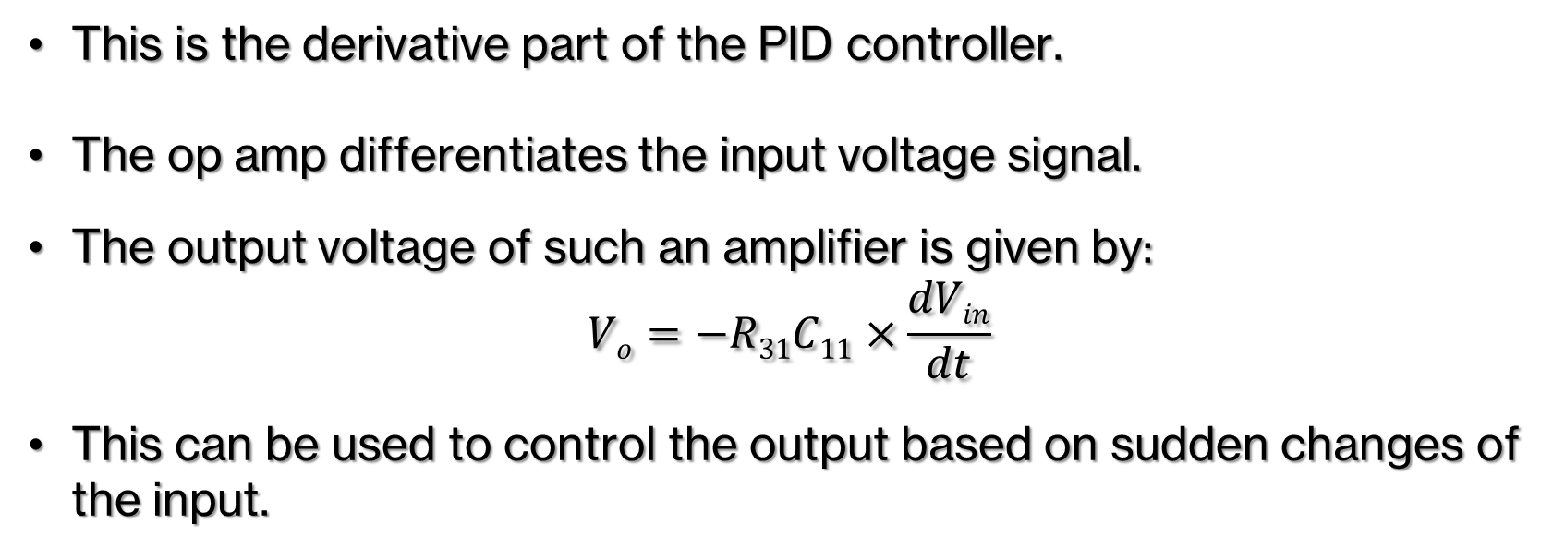
Functional Components
Derivative Controller
This is the derivative part of the PID controller.
The op amp differentiates the input voltage signal.
The output voltage of such an amplifier is given by:
$$Vo=−R31C11×\frac{dVin}{dt}$$
This can be used to control the output based on sudden changes of the input.

Slide 12
Functional Components
Derivative Controller
This is the derivative part of the PID controller.
The op amp differentiates the input voltage signal.
The output voltage of such an amplifier is given by:
$$Vo=−R31C11×\frac{dVin}{dt}$$
This can be used to control the output based on sudden changes of the input.

Slide 13
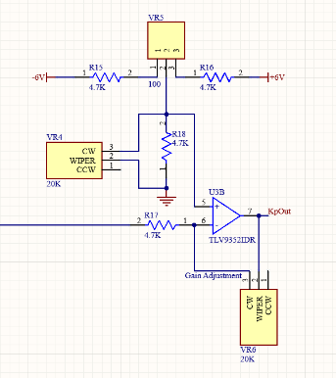
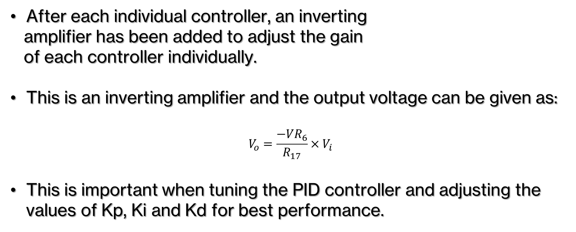
Functional Components
Gain Adjustment
After each individual controller, an inverting
amplifier has been added to adjust the gain
of each controller individually.
This is an inverting amplifier and the output voltage can be given as:
$$V_{o}=\frac{−{VR}_{6}}{R_{17}}×V_{i}$$
This is important when tuning the PID controller and adjusting the values of Kp, Ki and Kd for best performance.

Slide 14
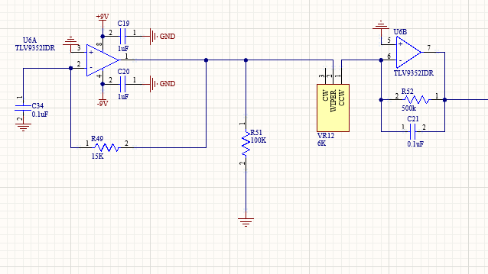
Functional Components
PWM Generation
The first stage in this is the generation of a square wave and it’s differentiation in order to produce a triangular wave

Slide 15
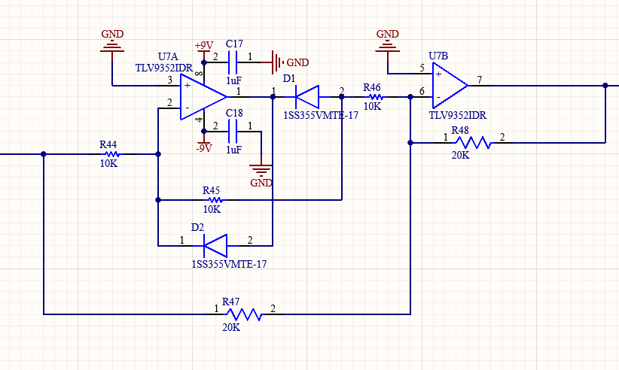
Functional Components
PWM Generation
Next, this is rectified. Parallelly, another setup also rectifies the error signal.

Slide 16
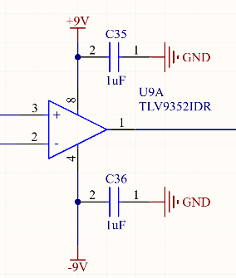
Functional Components
PWM Generation
Next, the rectified triangle wave and rectified PID output signal are sent through a comparator. The output is a PWM signal whose magnitude changes according to the magnitude of the PID signal..

Slide 17
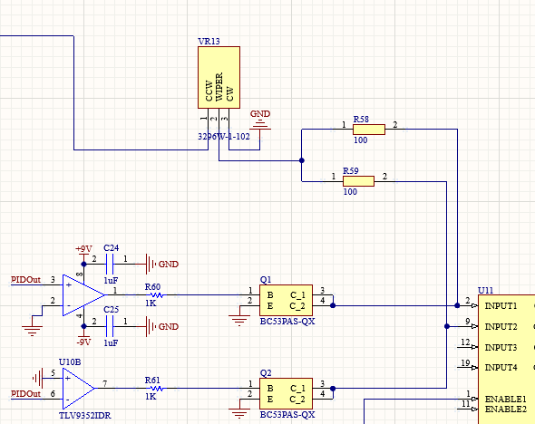
Functional Components
PWM Generation
The final stage of the motor control is to determine
the direction in which the motor should spin.
For this, the PID output is compared with 0V with
two comparators.
Based on whether PID output is positive or negative, one of the two op-amps shown will output a positive voltage and the other will output a negative voltage.

Slide 18
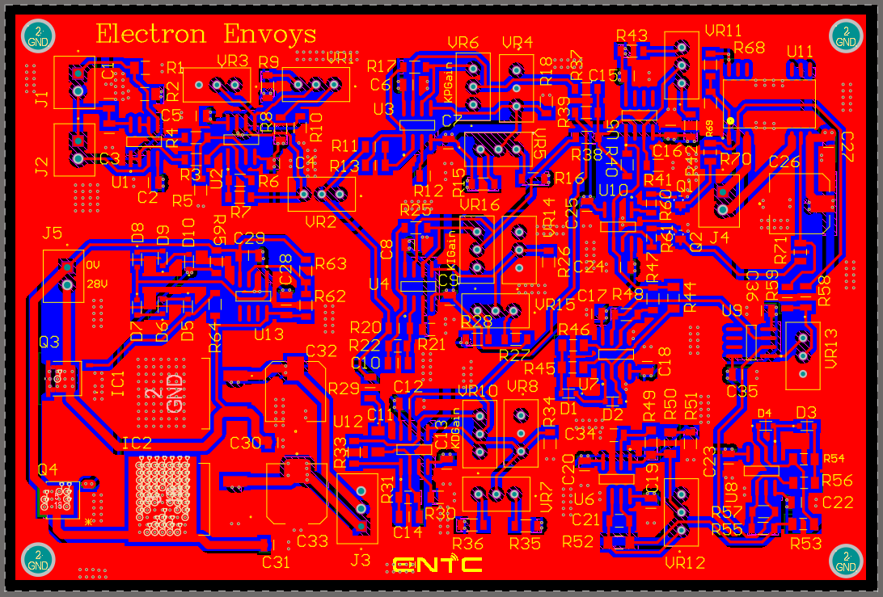
PCB Design
Top Layer -2D

Slide 19
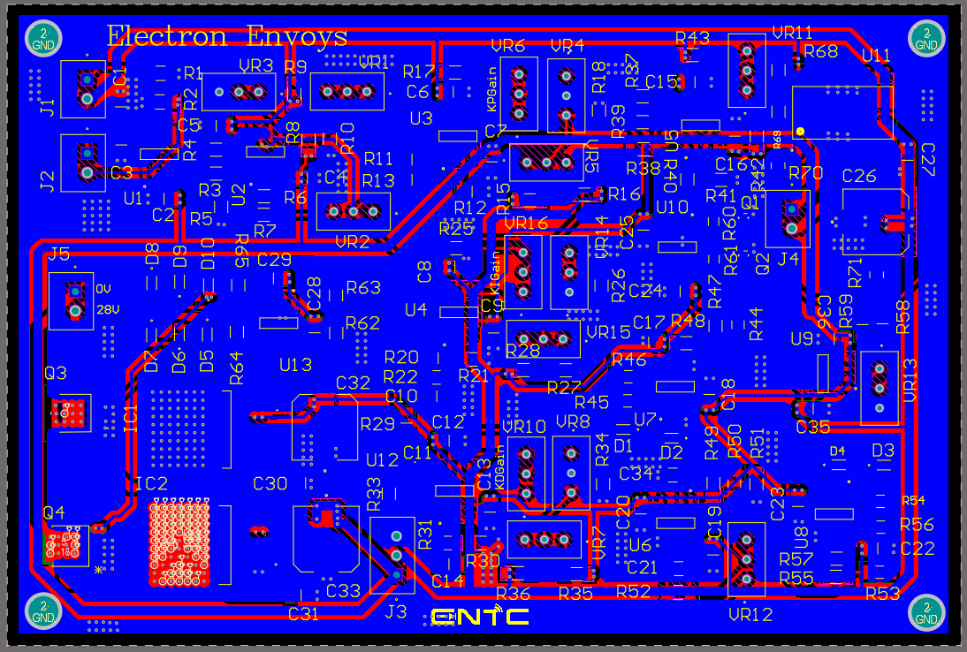
PCB Design
Bottom Layer -2D

Slide 20
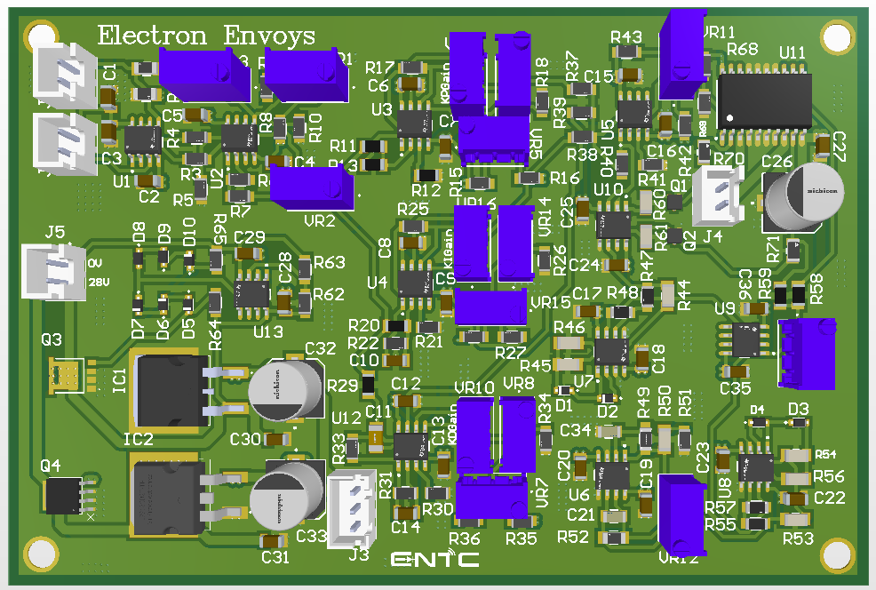
PCB Design
3D

Slide 21
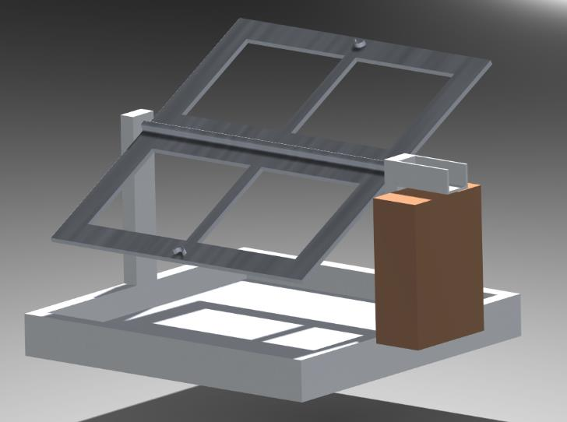
Enclosure Design

Slide 22
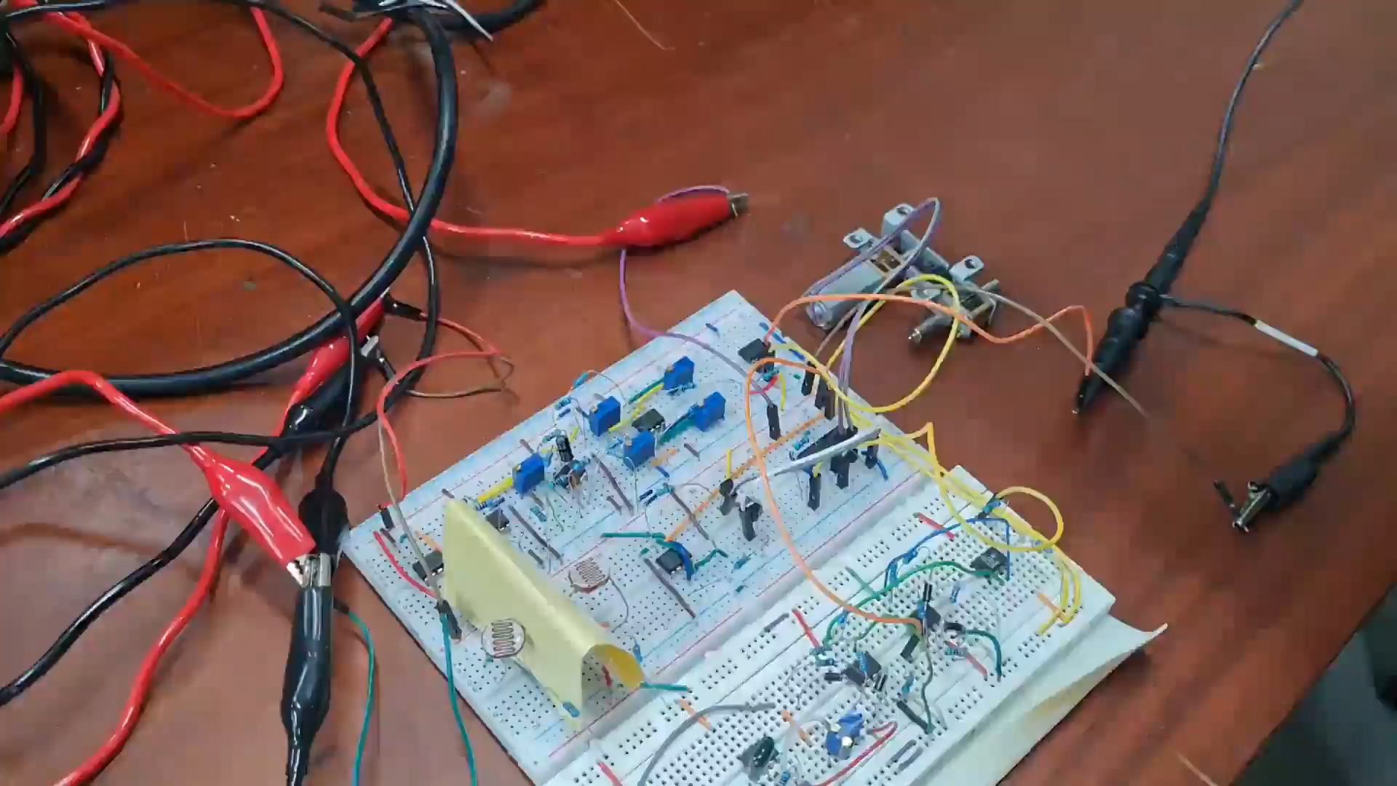
Initial Testing

Slide 23
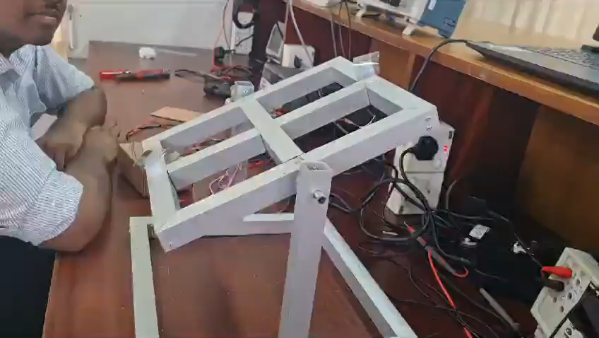
Final Results

Slide 24
Conclusion
The proposed system shows promising results.
Next steps:
Design the system to draw power from the solar panels
Design mounts for mounting on rooftops
Improve marketing to popularize the product
Design for different sizes

